Slide 1
Internet and Web Technology ICT- 2205 Lecture - 7
Presented By:
Mehrin Anannya
Lecturer
Institute of Information Technology
Jahangirnagar University.

Slide 2
Hypertext Transfer Protocol Communication
The basic HTTP communication model has four steps:
Handshaking: Opening a TCP connection to the web server.
Client request: After a TCP connection is created, the HTTP client sends a request message formatted according to the rules of the HTTP standard—an HTTP Request.
Server response: The server reads the request. It takes action creates an HTTP response message, which it sends back to the client. The response message indicates the request was successful.
Closing: Closing the connection (optional).

Slide 3
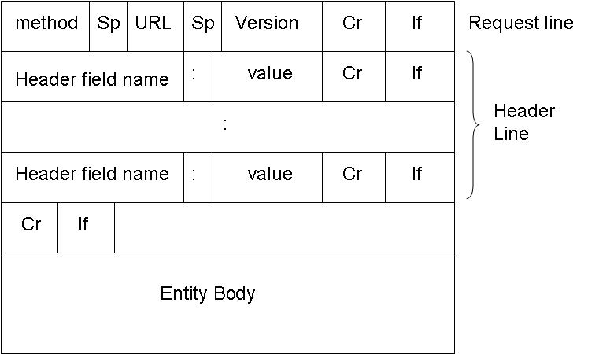
HTTP Request Message Format

Slide 4
Start Line /Request Line: It consists of three parts: the Request method, Request URI, and the HTTP version.
Request method: It indicates the type of the request a client wants to send.
Method = GET | HEAD | POST | PUT| DELETE| TRACE | OPTIONS|
CONNECT | COPY| MOVE

Slide 5
GET: Request server to return the resource specified by the Request-URI as the body of a response. It is the most frequently used method in the web. The message body is empty for the GET method. This method may also be used to send information to the server for processing without using an HTML form.
Ex: /test/demo_form.php?name1=value1&name2=value2

Slide 6
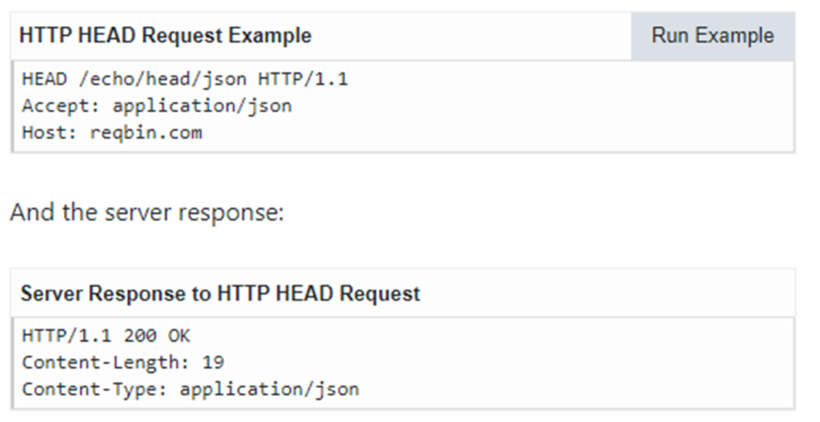
HEAD: Requests server to return the same HTTP header fields that would be returned if a GET method was used, but not return the message body that would be returned to a GET method.
Ex: The HTTP HEAD request is used to check the availability, size, and last modification date of a resource without downloading it.

Slide 7
POST: The most common form of the POST method is to submit an HTML form to the server. Since the information is included in the body, large chunks of data such as an entire file can be sent to the server.
Ex:POST/test/demo_form.phpHTTP/1.1 Host: w3schools.com name1=value1&name2=value2

Slide 8
PUT: It is used to upload a new resource or replace an existing document. The actual document is specified in the body part.

Slide 9
DELETE: Request server to respond to future HTTP request messages that contain the specified Request-URI with a response indicating that there is no resource associated with this Request-URI.
TRACE: Used primarily for test purposes by instructing the web servers to echo the request back to the client.
OPTIONS: It is usually used to check whether a server is functioning properly before performing other tasks.

Slide 10
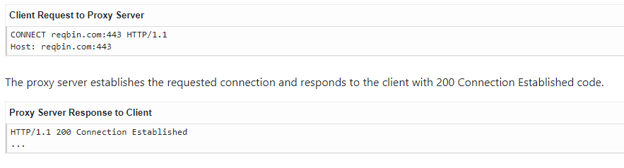
CONNECT: It is used to convert a request connection into the transparent TCP/ IP tunnel.

Slide 11
COPY: The HTTP protocol may be used to copy a file from one location to another. The method COPY is used for this purpose. This method is also vulnerable.
MOVE: It is similar to the COPY method except that it deletes the source file.
Request-URI: The second part of the start line is known as the Request-URI. It identifies the resource for which the request needs to be applied.
HTTP version: HTTP/1.1 version is used as it is the latest available version.

Slide 12
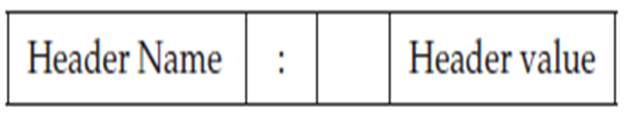
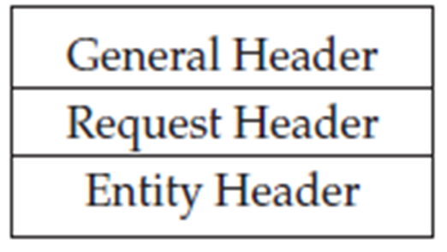
Headers:
A header consists of a single line or multiple lines.
Each header line consists of a header name followed by a colon (:), one or more spaces, and the header value, as shown in the following:
The header name is not case-sensitive; but the header value may be.
The HTTP protocol specification makes a clear distinction between general headers, request headers, and entity headers.

Slide 13
General Headers:
They are primarily used to specify the method for processing and handling messages. Some of the General headers with their brief description are given in the following:
• Date: Mon, 12 Sept 2016 16:09:05 GMT
• Connection: Close
• Warning: Danger. This site may be hacked!
• Cache-Control: no-cache

Slide 14
Request Headers:
It allows the client to pass additional information about themselves and about the request, such as the data format that the client expects. Some of the request headers with their brief description are given in the following:
• User-Agent: Mozilla/4.75
• Host: www.netsurf.com
• Referer: http://wwwdtu.ac.in/∼akshi/index.html
• Accept: text/plain

Slide 15
Entity Header:
It contains the information about the message body or the target messages in case of the request messages have no body. Some of the entity headers with their brief description are:
• Content-Type: mime-type/mime-subtype
• Content-Length: 546.
• Last-Modified: Sun, 11 Sept 2016 13:28:31 GMT
• Allow: GET, HEAD, POST

Slide 16
Message Body:
The message body part is optional for an HTTP message, but, if it is available, then it is used to carry the entity-body associated with the request.
If the entity-body is associated, then usually Content-Type and Content-Length header lines specify the nature of the associated body.
A message body is the one that carries the actual HTTP request data.

Slide 17
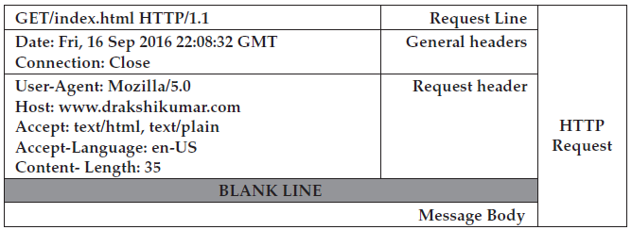
The example of HTTP request message with no message body is shown below:

